Slide 1
Review of Thermodynamics
1、Free Energy(自由能)：When one is concerned with changes in
the state of a system, a full description requires knowledge of
what is known as the free energy, including the Helmholtz free
energy and the Gibbs free energy.
Helmholtz free energy (F): a function of the internal energy E_{int}, the absolute temperature T, and the entropy S.
F = E_{int} – TS
Gibbs free energy (G) : Helmholtz free energy plus an additional term that depends on pressure and volume
G = F + PV = E_{int} – TS + PV

Slide 2
2、Equilibrium conditions：the general rule is that a system can
spontaneously alter its status if the change results in a lowering
of the free energy. Therefore the equilibrium condition is that
the free energy of the system is minimized.
For a mechanically isolated system at constant temperature (no work)
F ≤ 0 ( = holds at equilibrium )
For a system kept at constant temperature and pressure
G ≤ 0 ( = holds at equilibrium )

Slide 3
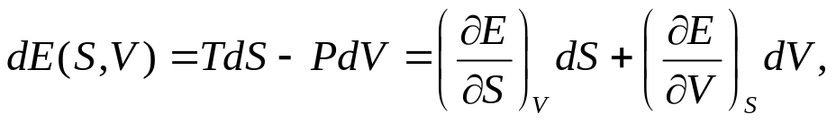


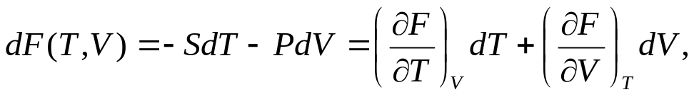
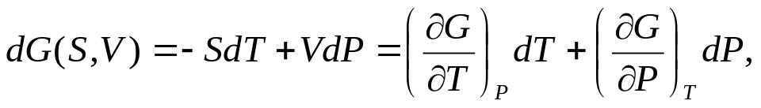
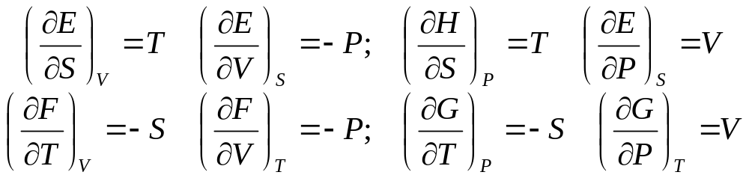
Thermodynamic Potentials:
Internal Energy (E_{int}), Enthalpy (H), Helmholtz Free Energy (F), Gibbs Free energy (G)
H = E_{int} +PV, F = E_{int}-TS, G = E_{int}-TS+PV
Maxwell Relations:

Slide 4
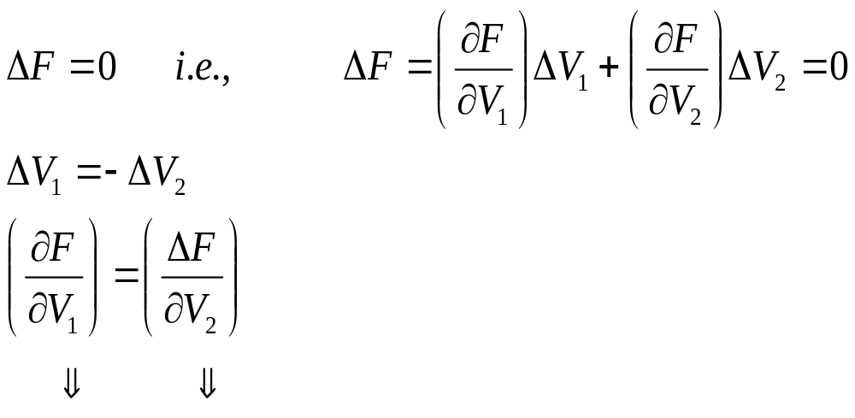
3、Example of the principle of minimizing free energy.
Consider an isolated ideal gas system consisting of two compartments of volume V₁ and V₂, respectively. The boundary between these two compartments is free to move Find the equilibrium condition.
Sol： For an isolated system, the equilibrium condition is
V₁
V₂
-P₁
-P₂
Equilibrium condition：P₁=P₂

Slide 5
4、Internal Energy
Consider two atoms in equilibrium
E_{kin} = 0
E_{pot} = 0
Small perturbation
t = 0
E_{kin} = 0 E_{pot} > 0
E_{kin} > 0 E_{pot} = 0
E_{kin} = 0 E_{pot} > 0
E_{kin} > 0 E_{pot} = 0
E_{kin} = 0 E_{pot} > 0

Slide 6
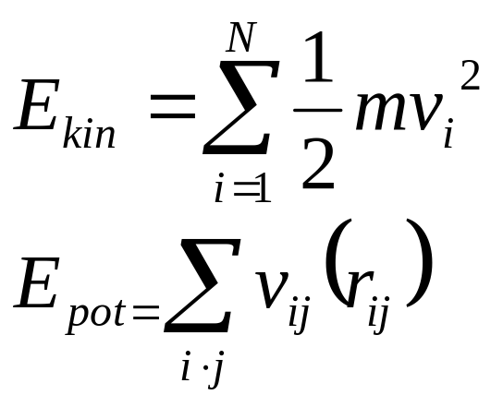
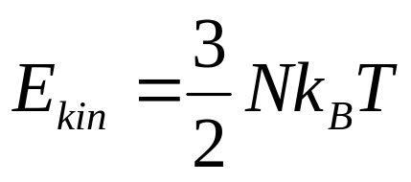
For a system of N particles
equipartition theorem
k_{B} = 1.38×10⁻²³JK⁻¹：Boltzmann constant
3N degrees of freedom
Each degree of freedom: ½ k_{B} T

Slide 7
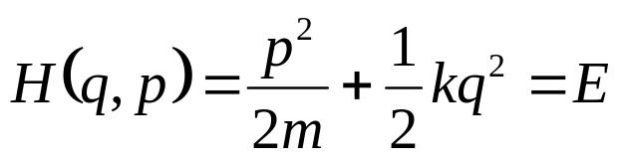
5、Entropy (S)
S = k_{B} ln Ω Ω：number of available states
a state involves both the positions and the velocities of all the atoms in the system.
Example: Consider a harmonic oscillator; Its Hamiltonian is
k
m
p = momentum q = position
phase space
Total available area in phase space = ΔW
Unit area in p-q phase space due to uncertainty principle is h
Number of states: Ω = ΔW／h
p
E
q
For a system of N particles in 3-D space
Ω (E,V,N) = ΔW(E)／h^{3N}
E+ ΔE

Slide 8



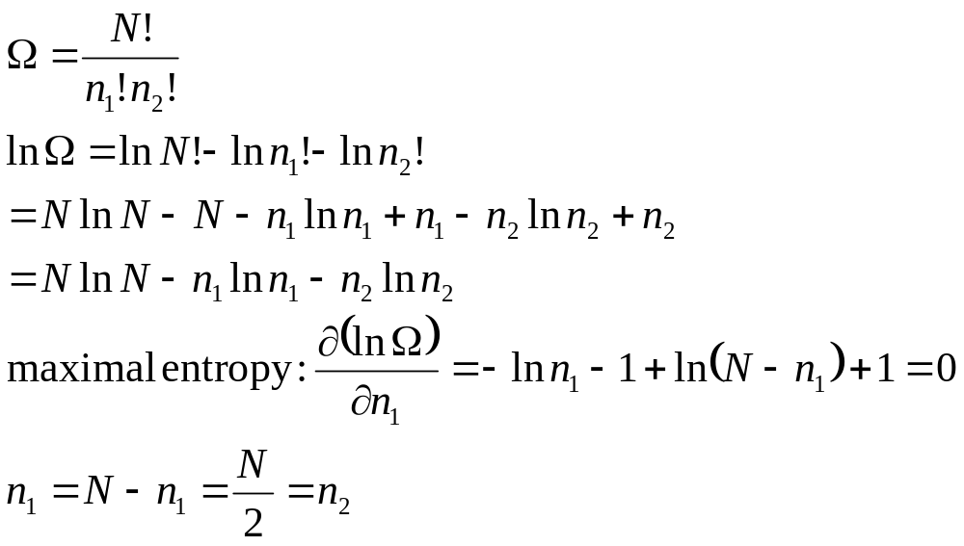
Example 2：A container is divided into two parts by a barrier that
has a small hole in it. The gas molecules are indistinguishable.
(a)
(b)
N
n₁
n₂
N = n₁ + n₂

Slide 9
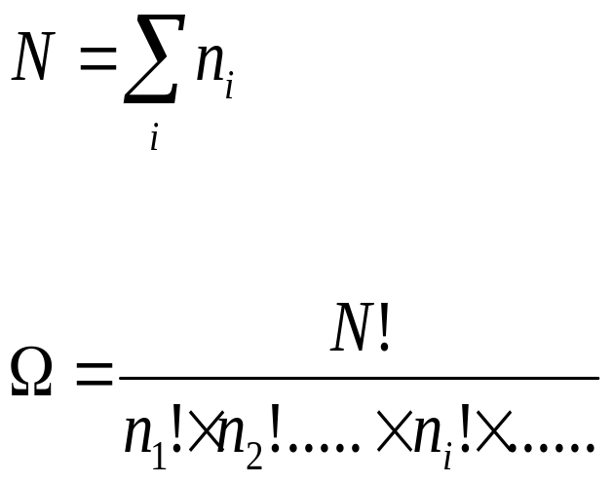
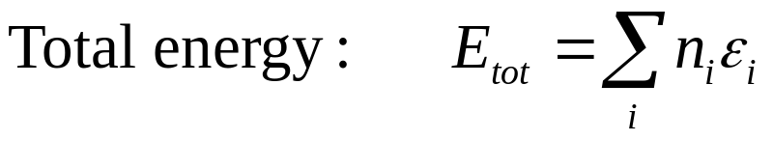
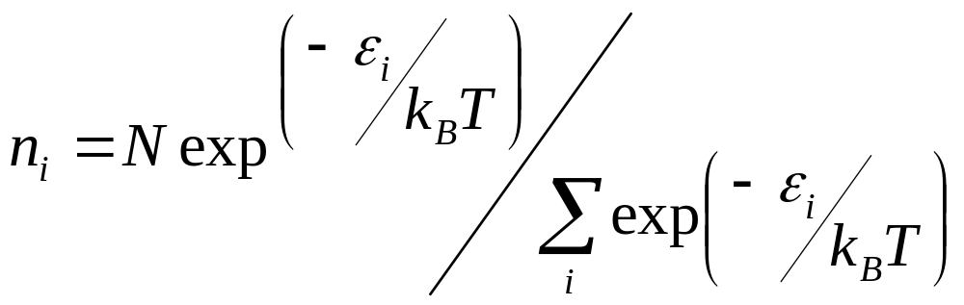
Consider a system that is described by a set of states 1, 2, 3, ...., i,....
with corresponding energies ε₁, ε₂, ε₃, … ε_{i},… Let the number of
particles in state 1 be n₁, in state 2 be n₂, …and so on.
Total number of particles:
Number of different ways:
Maximizing entropy with the constraints of particle number and total energy, we get

Slide 10
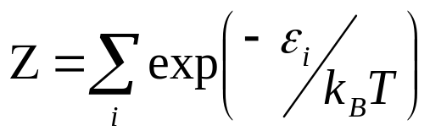
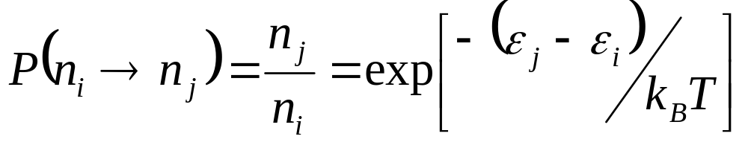
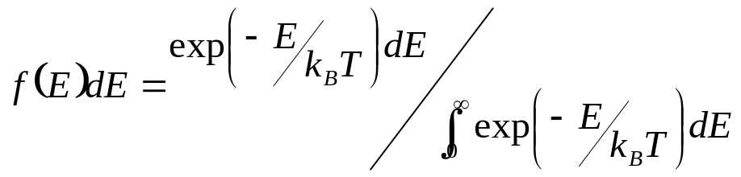
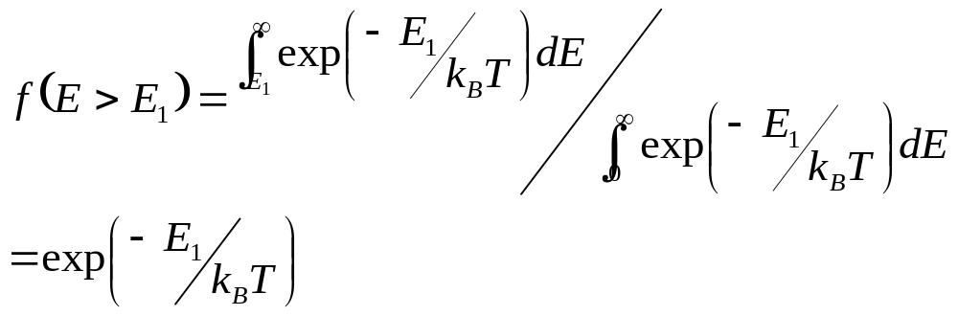
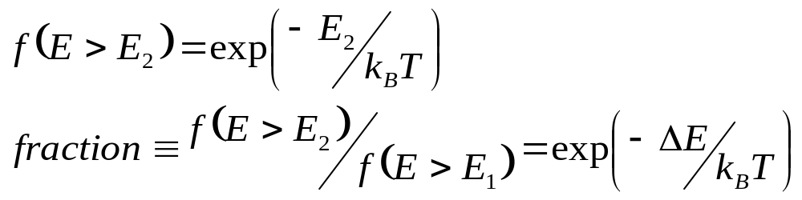
： partition function
At equilibrium, the probability to jump from state i to state j is
(detail balance)
E
E₂
ΔE
E₁
configurations

Slide 11
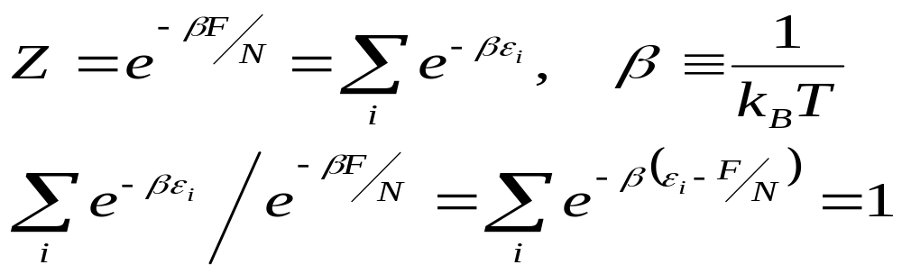
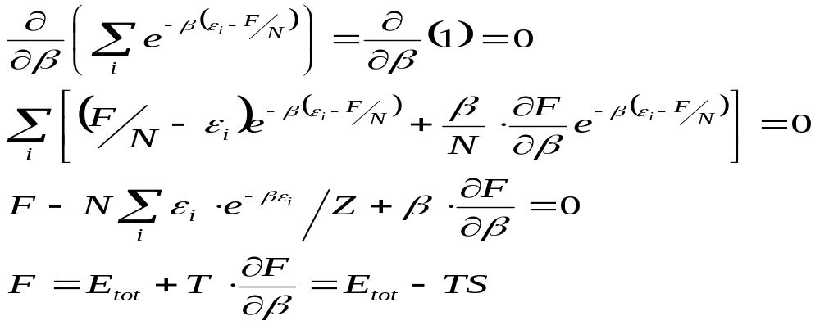
Connection between free energy and partition function
Define F = -Nk_{B}TlnZ what is F？
if F is the Helmholtz free energy

Slide 12
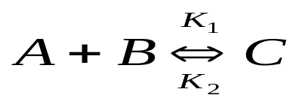
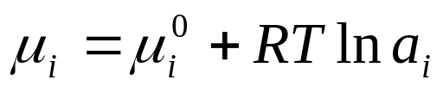


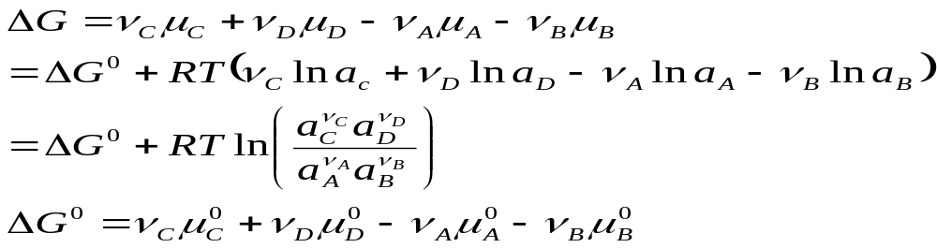

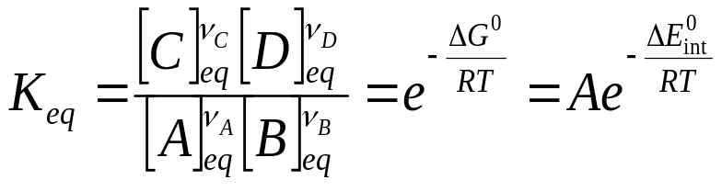
Reaction Kinetics
fist order
second order
reaction flux J_{c}=k₂[C] , J_{A}=J_{B}=k₁[A][B]
chemical potential of a given component
chemical activity
A more general reaction is
the change in the Gibbs free energy
At equilibrium
activation energy

Slide 13
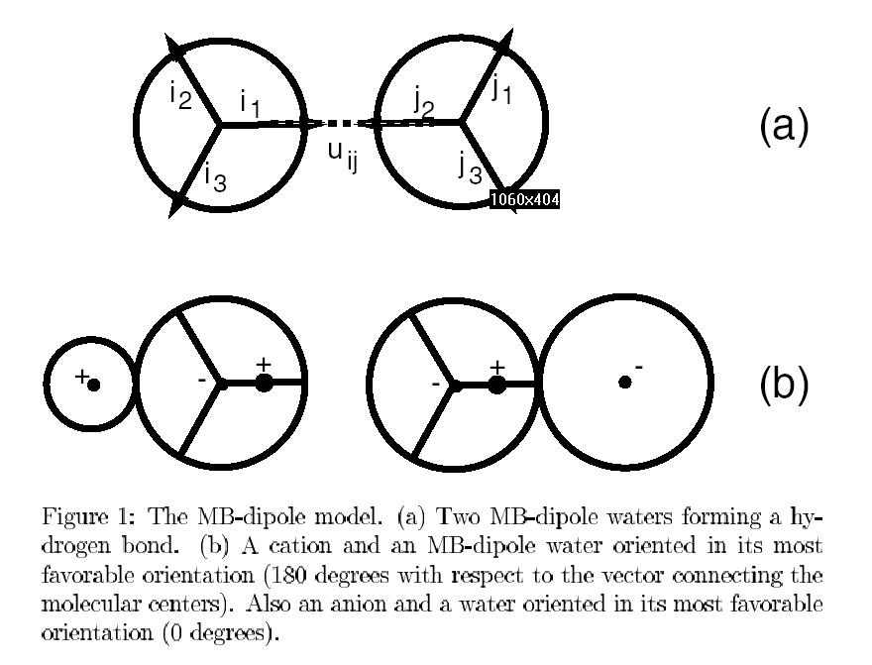
Water-- Mercedes-Benz model
The near-tetrahedral structure
of the water molecule provides
the basis for the most common
crystal structure of ice. Hydrogen
bonds in liquid water are
perpetually being formed and
broken. The hydrophobicity of
a non-polar molecule arises due
to the reduced entropy of water
in the presence of such a non-polar object, which plays an important role in biology. To study water, the MB model in 2-d provides a simplified view of ordering the water configurations in the presence of an ion or a non-polar molecule.

Slide 14
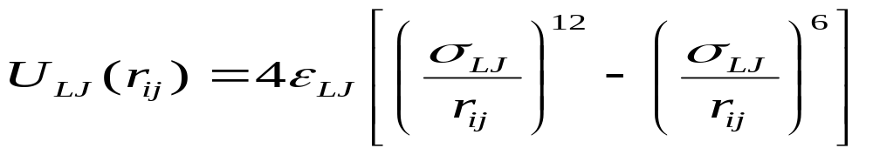
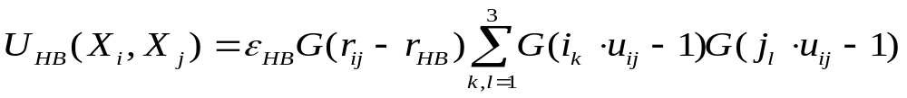

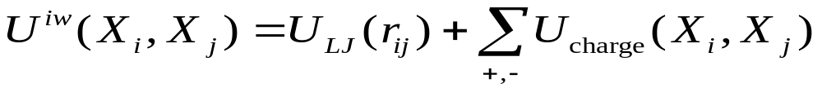
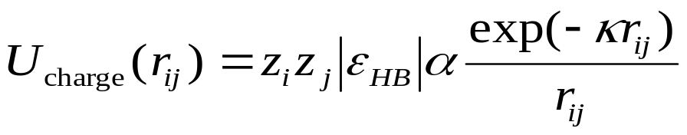
Molecular Interactions
water-water interaction
van der Waals’ term
Hydrogen bonding term
ion-water interaction

Slide 15
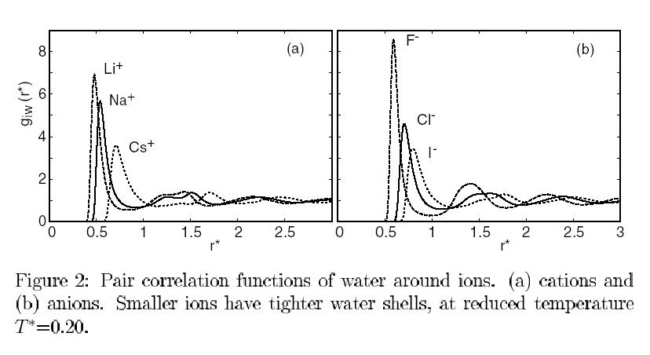
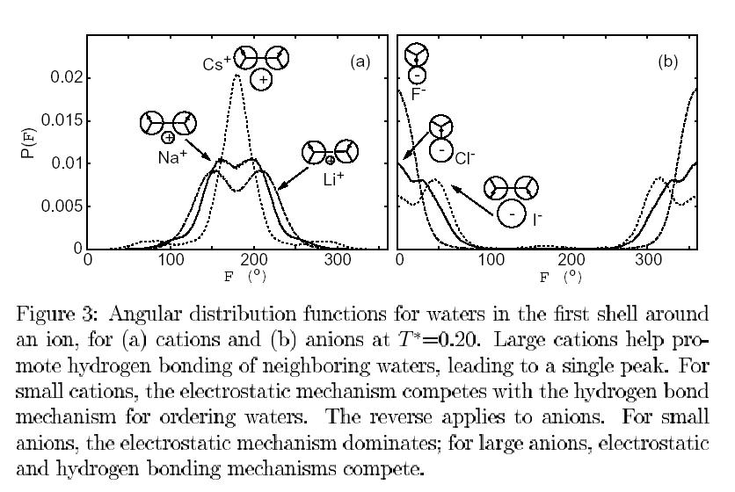
water distribution

Slide 16
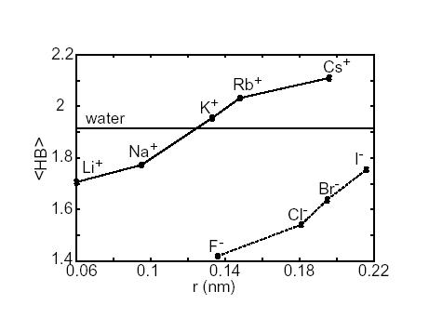
Average number of hydrogen bonds within the first water shell around an ion

Slide 17
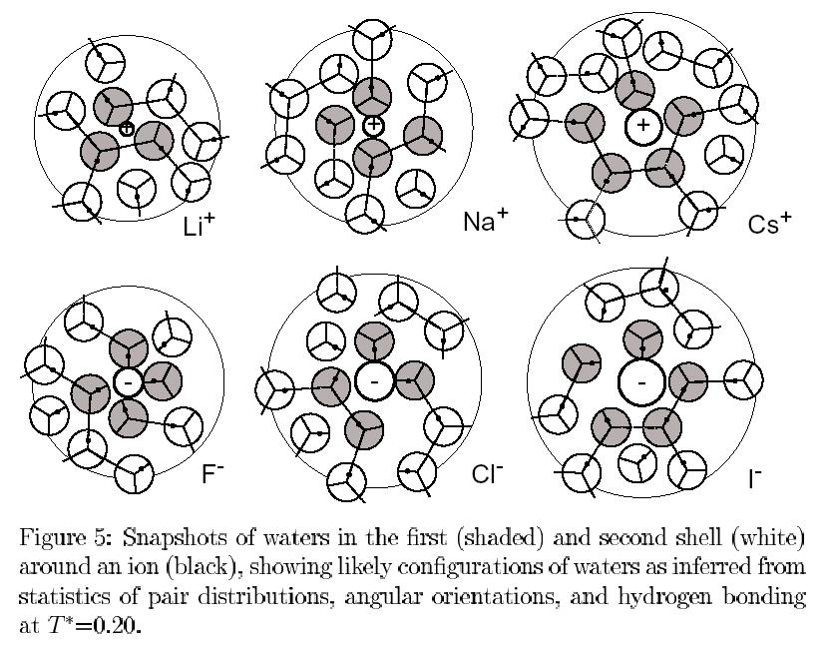

Slide 18
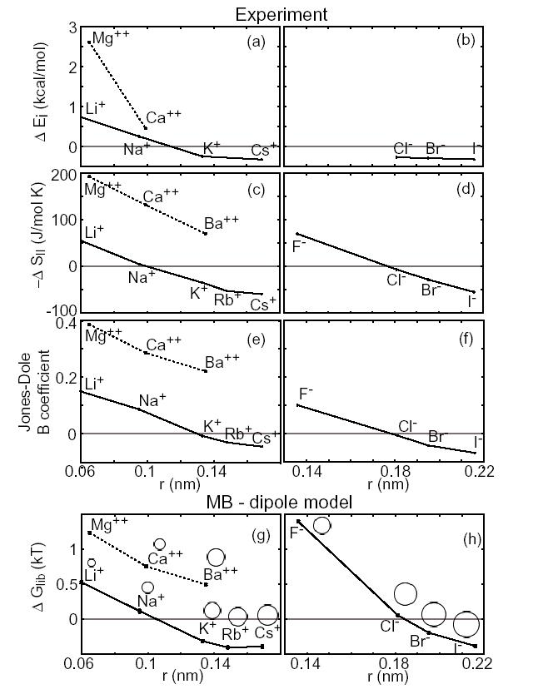

Slide 19
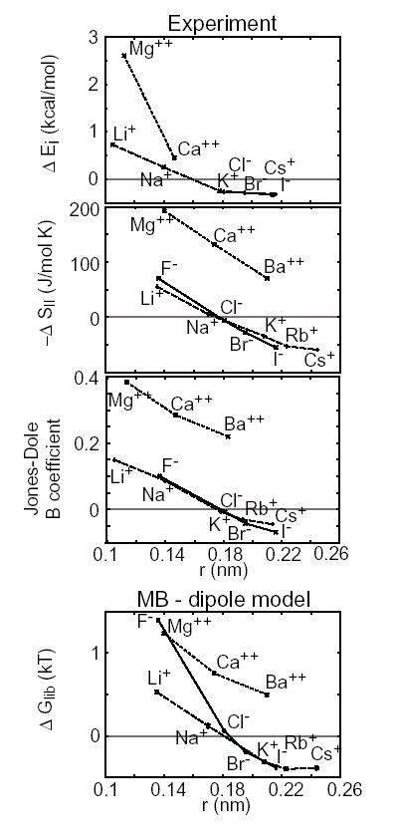

Slide 20
